Slide 1

Censorship and the Internet
By Geoffery Russo
October 9th 2018

Slide 2
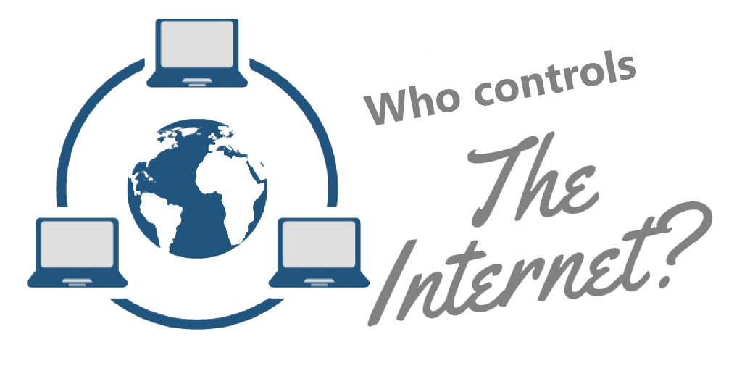

Slide 3
Who controls the internet
And enforces it?
The governments of the world? (USA, China, EU, Russia)
Search engines? (Google, Yahoo, Bing)
The Internet Engineering Task Force? (IETF )
The Internet Corporation for Assigned Names and Numbers? (ICANN)

Slide 4
The Purpose Of The Internet
Developed for communication in the event of a nuclear war.
It grew and expanded in the 70s through the use of TCP/IP (Transmission Control Protocol).
Protocols allowed the internet to become a resource sharing network of networks.

Slide 5

Internet Freedom, our first priority

Slide 6

What is censorship?
The suppression or prohibition of any parts of a books, films, news, etc. that are considered obscene, politically unacceptable, or a threat to security.

Slide 7
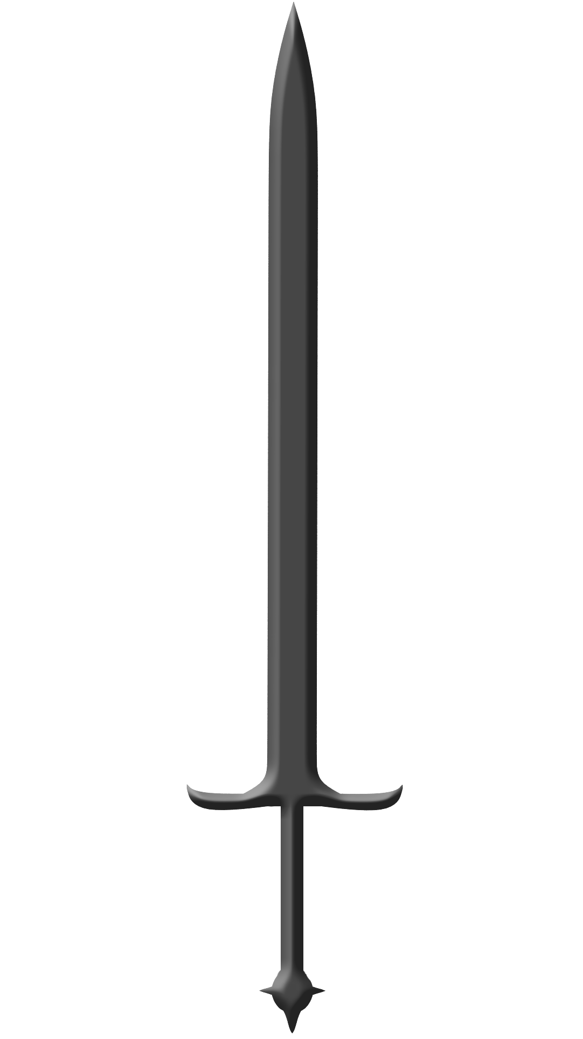
Pros Cons
Some things are illegal and should not be allowed for access on the internet.
Information that is a matter of national security
Takes away the ability to share information regardless of where you are and who you are
Censorship is a violation of human rights

Slide 8

The Internet Is Censored!
Varies from country to country.
Very restrictive governments have far more censorship then countries that promote free speech.
Rogue nations make the internet illegal.

Slide 9

But…..
Canada and United states are protected by freedom of speech laws.
There is no jurisdiction over the darkweb…
Using proxies to sneak around restricted info.

Slide 10
How it works
There are three main types of censorship
DNS based where a country changes its local servers.
IP and port blocking, its a massive firewall the country puts up.
Deep packet inspection, it can filter out keywords and use both methods above.

Slide 11

Project Dragonfly
Google's new search engine made for the Chinese Government
Lead to employees working on it to quit including a now former senior scientist Jack Poulson
The search engine allows for the Chinese government to monitor the users on the Google app and can also blacklist various queries that president Xi Jinping does not want people to access

Slide 12
Yahoo! vs. LICRA
The problem with a borderless world, clashing of cultures and laws
The selling of racist memorabilia (Nazi, KKK)
France ordered Yahoo! to compile or pay a fine
Both the USA and Yahoo! Received media backlash over the issue from both sides
One being the sale of racist items
The other being the USA getting censored by foreign powers

Slide 13
Legal Limits On The Internet
Depends where you live as laws may vary.
There is a grey area with copyright and the internet, some cases its illegal and others its not.
The European Union is trying to combat this with a proposed law article 13.

Slide 14

Is censorship in your hands?

Slide 15
Citation
Barney Warf. 2010. Geographies of global Internet censorship. (November 2010). Retrieved October 7, 2018 from https://link.springer.com/article/10.1007/s10708-010-9393-3
John Naughton. 2016. The evolution of the Internet: from military experiment to General Purpose Technology. Journal of Cyber Policy 1, 1 (February 2016), 5–28. DOI:http://dx.doi.org/10.1080/23738871.2016.1157619
Theintercept. 2018. Google Plans to Launch Censored Search Engine in China, Leaked Documents Reveal. (August 2018). Retrieved October 9, 2018 from https://theintercept.com/2018/08/01/google-china-search-engine-censorship/
(TI yahoo! inc. v. licra) AND (SO "Berkeley Technology Law Journal")
Eaton, J. (2015, Apr 20). Scaling the firewall: Ways around government censorship online. The Christian Science Monitor Retrieved from https://login.proxy.hil.unb.ca/login?url=https://search-proquest-com.proxy.hil.unb.ca/docview/1674256172?accountid=14611
D. Banisar. 2002. Virtual borders, real laws [Internet activity and treaties]. IEEE Spectrum 39, 10 (2002), 51–52. DOI:http://dx.doi.org/10.1109/mspec.2002.1038572

Slide 16
Citation cont.
Carrie Liddy. 1996. Commercial security on the Internet. Information Management & Computer Security 4, 1 (1996), 47–49. DOI:http://dx.doi.org/10.1108/09685229610114222
Evgeny Morozov. 2011. Whither Internet Control? Journal of Democracy 22, 2 (2011), 62–74. DOI:http://dx.doi.org/10.1353/jod.2011.0022
Anon. 2000. EUROPE | France bans internet Nazi auctions. (May 2000). Retrieved October 7, 2018 from http://news.bbc.co.uk/2/hi/europe/760782.stm
T. Lewis. 1998. Who owns the Internet? IEEE Internet Computing 2, 1 (1998), 82–84. DOI:http://dx.doi.org/10.1109/4236.656087

